Slide 1


Term project: Alteryx as a DBMS and self-service platform
Alex Deshowitz
MSDS 7330-401
November 28, 2016

Slide 2
Agenda
What is Alteryx?
Feature comparisons
Conclusions

Slide 3
Executive summary
This project evaluated the usage of Alteryx as a self-service analytics platform with Microsoft Access used as a baseline for comparison.
The evaluation focused on 4 key areas of usage:
  Query speed
  Ease of data manipulation and workflow interpretation
  Automation
  Storage capacity
While the results were mixed depending on the perspective of the analyst, it was also discovered that an open source version of Alteryx called Knime is readily available and has additional functionalities not present in Alteryx.
The ultimate conclusion is that there is no one best-fit tool for an analyst to use when designing databases and workflow. The ultimate decision comes down to preference (both team and individual), project objective, and the amount of resources available for costly software packages.

Slide 4
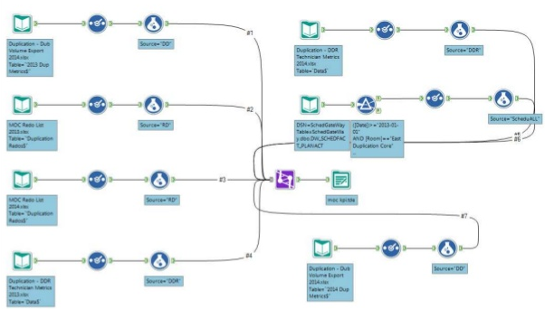
What is Alteryx?
Alteryx is a tool that can be used for advanced data blending, querying, and analytics. The tool can be joined up with other packages such as Tableau, R, and SAS
Example Alteryx workflow
Screen capture of 4 source data model
Key features
Alteryx bears much resemblance to ETL tools
Allows for connections ranging from text files to ODBC and Hadoop
Offers ability to process in-database
Incorporates R-code and packages without the user needing to learn R
Offers automation capabilities such as e-mail and scheduled tasks
All actions happen via drag and drop “tools”
Active developer community
Integrates with Tableau and other BI tools

Slide 5
Feature comparisons: Query speed test
For the query speed assessment, Alteryx was compared with Access via 30 random query loops in each tool. Ultimately, Access proved to query the data quicker in a statistically significant fashion (p<.001)
Alteryx versus Access summary statistics
Query times in seconds
Paired t-test specifications
Hardware: Dell Latitude E5430 non-vPro, 32-bit, Intel Core i5 (2.6 Ghz/2-cores), Windows 7 Enterprise, 4.0 Gb RAM
Hypothesis:
  Ho: μ_{Alteryx}- μ_{Access} = 0
  Ha: μ_{Alteryx}- μ_{Access} > 0
Conclusion:
  Reject the null
  The evidence strongly suggests that the difference in query times between Access and Alteryx is greater than zero
  P-value: <0.0001
  95% confidence interval: [5.5,11.2] seconds
Notes: Both distributions were log transformed due to high levels of positive skewness in the result sets
 | Alteryx | Microsoft Access
Min. query time | 19.1 | 4.1
Lower quartile | 17.6 | 5.2
Median | 18.3 | 9.1
Mean | 19.1 | 10.8
Upper quartile | 19.4 | 14.6
Max. query time | 29.5 | 37.0
Standard deviation | 2.6 | 7.3
Note: For equal comparisons, in-database processing was not used in this example. Additionally, in-database processing was not officially supported in the version of Alteryx being used

Slide 6

Feature comparisons: Database size constraints
Both databases appear to have similar limitations when it comes to size (around 2Gb); however, Alteryx appears to be more sensitive to larger files sizes and tends to take more room to store the same data
Alteryx versus Access process flow
Data added in 1 month aggregates
A
B
Both programs became unresponsive once 2 months of data were pulled into the model. This equated to about 14 million records at the specified level of aggregation
It should be noted that Alteryx ran; however, the data was not accessible even via the use of the caching tool
The Access database quit compiling data once the database got to about 2GB.
For some reason, the Alteryx database tended to be a lot larger for the same data that was stored in Access.
Alteryx does have the capability to work with large data files; however, this type of work is best suited for the in-database processing feature.
 | Access |  |  | Alteryx
Range | File size | Create time | Access time | File size | Create time | Access time
1 month | 238.5Kb | 10 min | 3 sec | 1.9 GB | 12 min | 3 sec
2 month | 2.01 GB | NA | NA | 4.1 GB | 45 min | NA

Slide 7
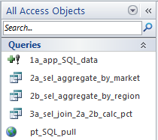
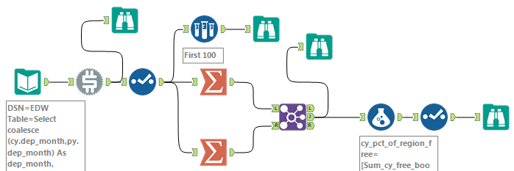
Feature comparisons: Data and workflow manipulation
Those who are more comfortable with an ETL or visual approach will be more comfortable with the Alteryx format over more traditional database processing steps…
Query replicated in both programs
A
B
Microsoft Access
Alteryx
Functionality aside, the preference for which tool to use really comes down to analytical preference…
Note: For equal comparisons, in-database processing was not used in this example. Additionally, in-database processing was not officially supported in the version of Alteryx being used

Slide 8
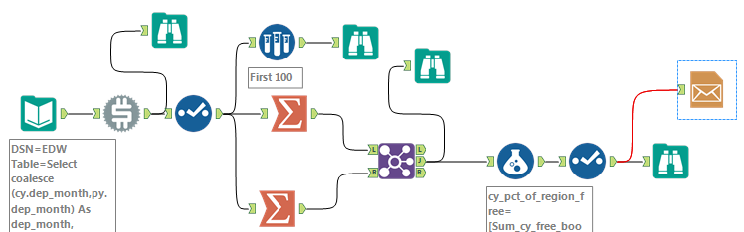
Feature comparisons: Automation
The main advantage of Alteryx over Access in the realm of automation is the lack of VBA; however, the codeless automation environment allows for less customization and external GUIs for end users
Email automation example
A
B
Microsoft Access
Alteryx
Public Function EmailUpdate()
Dim oConfig As Object
Dim oMessage As Object
Dim strCfg As String
strCfg = "http://schemas.microsoft.com/cdo/configuration"
Set oMessage = CreateObject("CDO.Message")
With oMessage
.subject = "FP&A O&D Poo Data"
.From = "FP&ATools@wnco.com"
.To = "alex.deshowitz@wnco.com ; martin.prichard@wnco.com; adam.bransford@wnco.com; brendan.sheehy@wnco.com"
.TextBody = "Good Morning" & vbNewLine & vbNewLine & _
"The FP&A O&D Poo dataset has been updated as of: " & Now() .Configuration.Fields.Item("http://schemas.microsoft.com/cdo/configuration/sendusing") = 2 .Configuration.Fields.Item("http://schemas.microsoft.com/cdo/configuration/smtpserver") = "smtp.luv.ad.swacorp.com" .Configuration.Fields.Item("http://schemas.microsoft.com/cdo/configuration/smtpserverport") = 25
.Configuration.Fields.Update
.Send
End With
Set oMessage = Nothing
End Function
Note: For equal comparisons, in-database processing was not used in this example. Additionally, in-database processing was not officially supported in the version of Alteryx being used

